Slide 1
Main Results (1/2)
Consider the Dorfman two-stage algorithm.
Traditionally, the samples mixed in a group are assumed to be i.i.d. Bernoulli random variables.
In practice, samples are not i.i.d.
For a contagious disease like COVID-19, people in the same family (or social bubble) are likely to infect each other. Thus, they are likely to be positively correlated.

Slide 2
Main Results (2/2)
We prove further cost reduction can be achieved when samples within a group are positively correlated.
Case I: i.i.d. samples
Case II: positively correlated samples
G₁
G₂
G₃
G₄
G₅
G₁
G₂
G₃
G₄
G₅
→ # of tests = 5 + 4 x 5 = 25
→ # of tests = 5 + 2 x 5 = 15

Slide 3
Pooled Testing on a Graph (1/5)
Suppose that there is a social network modeled by a graph G = (V, E), where V is the set of nodes, and E is the set of edges.
A node in G represents a person in the social network, and an edge between two persons represents frequent social contacts between these two persons.
As a contagious disease can propagate the disease from an infected person to another person through the social contacts between these two persons, two persons connected by an edge are likely to infect each other.
Two samples obtained from two persons connected by an edge are also likely to be positively correlated.

Slide 4
Pooled Testing on a Graph (2/5)
The question for pooled testing on a graph G = (V, E) is how we exploit positive correlation from the edge connections in a social network to save pooled testing costs.
A set of nodes that are densely connected to each other are likely to be positively correlated. Such a set of nodes is called a community.
The idea for addressing the pooled testing problem on a graph is to detect communities in a graph and then pool samples in the same community together for pooled testing.

Slide 5
Pooled Testing on a Graph (3/5)
The Zachary karate club friendship network.
Notes:
空手道社
In 1970s at an university
1: instructor
34: administrator

Slide 6
Pooled Testing on a Graph (4/5)
The hierarchical agglomerative algorithm
Every node in the input graph is assigned to a set (community) that contains the node itself.
Recursively merges two sets that have the largest covariance into a new set.
Append one set to the end of the other set so that the order of the elements in each set can be preserved.
Each merge of two sets reduces the number of sets by 1.
Eventually, there is only one remaining set, and the order of the elements in the remaining set is the pooling strategy.

Slide 7

Pooled Testing on a Graph (5/5)
The dendrogram for the Zachary karate club friendship network.

Slide 8
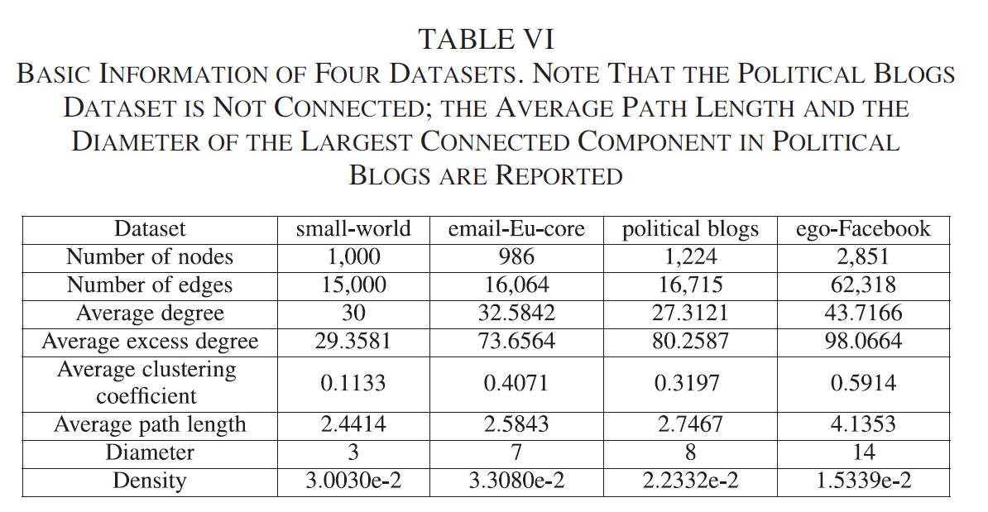
Numerical Results (1/3)
Datasets

Slide 9
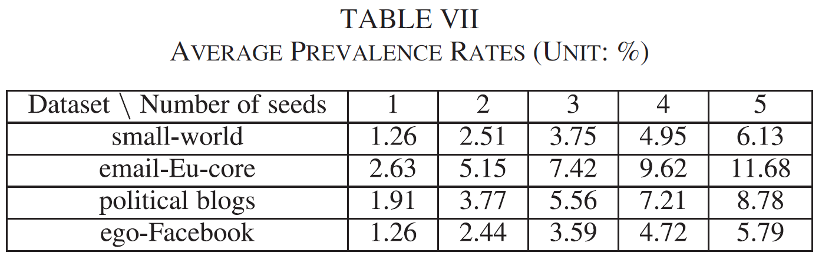
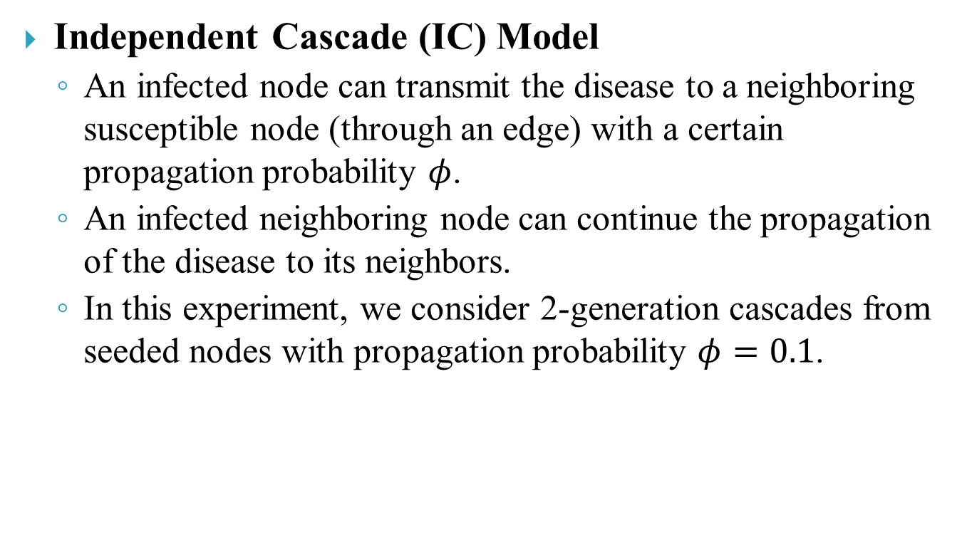
Numerical Results (2/3)
Independent Cascade (IC) Model
An infected node can transmit the disease to a neighboring susceptible node (through an edge) with a certain propagation probability $φ$.
An infected neighboring node can continue the propagation of the disease to its neighbors.
In this experiment, we consider 2-generation cascades from seeded nodes with propagation probability $φ=0.1$.

Slide 10
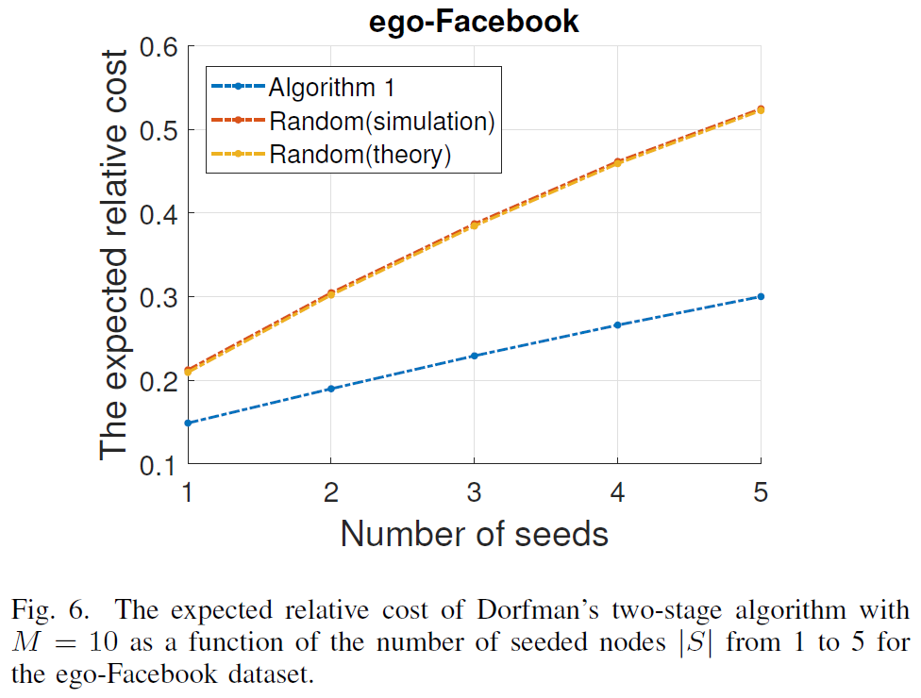
Numerical Results (3/3)

